Slide 1
VA Pension Benefit
Filing a Claim
In house intake information needed to start a claim and a guide as to what forms we will use are on the information table.
If you want to file a claim please take one and fill it out and bring it to our office.
How to file a Pension Claim

Slide 2
This type of “Pension” does not mean Retirement. It is a term used by the VA for a low income monthly monetary benefit. A veteran or a surviving spouse or child might qualify for this Pension.
Pension is for Low Income, Low Net Worth
Three Types of Pensions for Veterans and Survivor’s
Pension – Very low income assistance.
Housebound – Not able to leave the home.
Aid and Attendance - Nursing Home or Assisted Living.
The VA pays a set amount for each type of Pension and divides it into monthly payments into your direct deposit bank account.
Follow the link below for more information. See fact sheet on the information table.
https://www.va.gov/pension

Slide 3
What are the benefits of joining a
Veterans Service Organization?
Local Area Posts:
American Legion – Dugger, Hymera, Shelburn, Sullivan and Carlisle Prison
AMVETS – Hi-Way 40 west of Terre Haute
VFW – Sullivan
American Legion Membership – does not have a wartime requirement now
Contact information for these are on the table.
Also there are membership opportunities for spouses, children and grandchildren.
i.e., Auxiliary & Sons.
Membership Benefits:
Helping fellow veterans, boys and girls state, other programs, they lobby congress
for veteran benefits. Receive Discounts on Auto Rental, Financial & Insurance,
Media & Entertainment, Medical, Moving & Relocation, Retail, Travel & Lodging.

Slide 4
Steps to file for a VA Pension Claim For Veteran: Veteran must have served wartime. For Surviving Spouse/Child: Survivor’s spouse, children must have served wartime. https://www.va.gov/pension/survivors-pension/
VA Pension Benefit

Slide 5
Wartime Dates
Mexican Border Period (May 9, 1916 – April 5, 1917 for Veterans who served in Mexico, on its borders, or adjacent waters)
World War I (April 6, 1917 – November 11, 1918)
World War II (December 7, 1941 – December 31, 1946)
Korean conflict (June 27, 1950 – January 31, 1955)
Vietnam era (February 28, 1961 – May 7, 1975 for Veterans who served in the Republic of Vietnam during that period; otherwise August 5, 1964 – May 7, 1975)
Gulf War (August 2, 1990 – through a future date to be set by law or Presidential Proclamation)

Slide 6
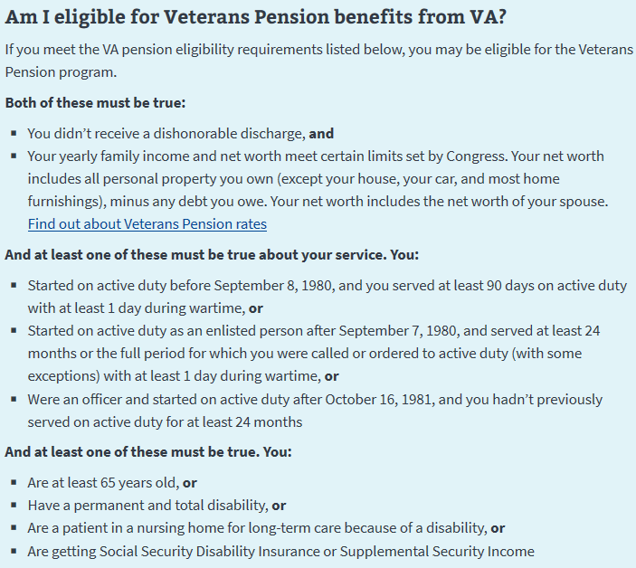
Pension is for Low Income, Low Net Worth

Slide 7
Pension is for Low Income, Low Net Worth
Must haves in order to file for Veteran Pension or Survivor’s Pension.
DD-214 or other separation documents
Out of Pocket Medical expenses
Proof - Assisted Living or Nursing Home facility that you are paying.
For Housebound need out of pocket medical expenses
House, Car and household goods are not figured in as net worth.
Marriage license
Death Certificate for Survivor’s Pension.
Doctor’s diagnosis that you need help with daily living needs, ADLs.
Bathing, dressing, eating, toileting, transferring etc. Need two (2) needs to qualify for a Aid & Attendance in Assisted Living/Nursing.
Net worth - see next slide
See the Veteran Pension or Survivor’s Pension sheet on the information table

Slide 8
Pension is for Low Income, Low Net Worth
Eligibility
Income:
Must be under the Bright-Line amount which is $129,094.
Bright Line = Example: Annual income is $24,000 + net worth of $20,000 = $48,000 Okay because it is below $129,094 which is the bright line maximum.
Net worth:
Does not include your home, cars or household goods.
Includes Bank accounts, investments, property other than 2 acre residence.
Home sitting on up to 2 acres is okay but more acreage is counted as net worth.
If you are over the “Bright-Line” do not apply now.
You need to spend down then reapply when below $129,094 bright-line.
Three year look back period for asset transfers starting from date of application.
Penalty if the VA finds out about transfers to lessen net worth.
Cannot sell for under the value in order to qualify for the Pension Benefit.

Slide 9
Pension is for Low Income, Low Net Worth
Eligibility continued
To lower income levels - Deduct the unreimbursed out of pocket medical expenses from income, lowering your income. Examples of unreimbursed medical expenses include Medicare, insurance premiums, in-home care, and assisted living / nursing home costs.
Example:
Veteran with no dependent receiving Aid & Attendance would get a maximum annual amount of $22,577 which is the Maximum Allowable Pension Rate (MAPR). An amount below $22,577 the VA pays the difference.
(Assisted Living cost + medical costs is $54,000 annually). [Calculating the amount VA will pay is $54,000 - $24,000=(-)$30,000] well below the MAPR of $22,577
so the veteran gets the maximum MAPR of $22,577.
($22,577 / 12 = $1,881.42) per month.

Slide 10
Pension is for Low Income, Low Net Worth
Veteran getting Medicare is in need of home health care
Contact Area 7 - Robin Walsh Sullivan County social worker at 812-238-1561 ext-238
Visits by a nurse and someone to assist with other items.
VA social worker at Terre Haute VA Clinic 812-478-1825
Must be enrolled in VA Health Care for home health care – they offer respite care if qualified.
To qualify for a Primary Caregiver for a veteran – Served Sept 11, 2001 or after, disability must be service related to service, etc.
Has a serious injury—including traumatic brain injury, psychological trauma, or other mental disorder—that was caused or made worse by their active-duty service on or after September 11, 2001, and
Needs personal care services because they can’t perform one or more activities of daily living and/or needs supervision or protection based on symptoms of lasting neurological damage or injury

Slide 11
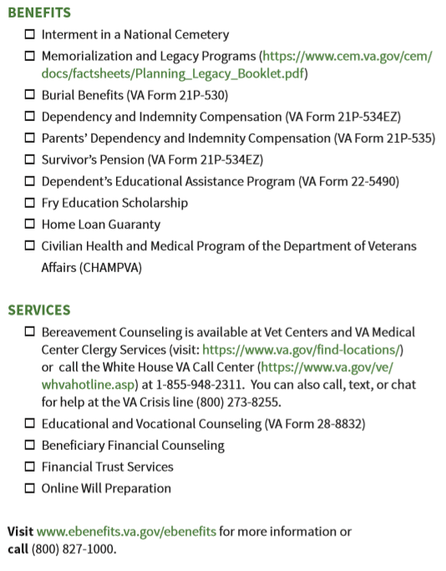
Survivor’s Benefits
What can a Survivor of a Veteran receive from the VA if eligible?
https://www.va.gov/survivor-quick-start-guide.pdf

Slide 12
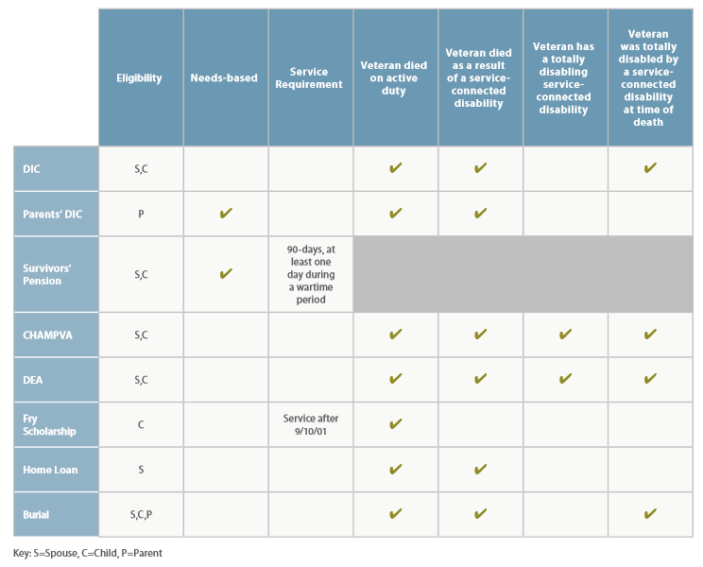
Miscellaneous Benefits Federal
See the fact sheet on the table.
For Survivor’s of Veterans.
https://benefits.va.gov/BENEFITS/benefits-summary/SummaryofVADependentsandSurvivorsBenefits.pdf

Slide 13
Dependent Indemnity Compensation (DIC)
(DIC) is a monthly tax-free benefit provided to an eligible surviving spouse, dependent child(ren), and/or parent(s) of a deceased Servicemember or Veteran.
You may be eligible for DIC benefits if you are a surviving spouse, dependent child, or parent of a Veteran who meets the requirements like died of their service connected disabilities.
There are also marriage requirements.
See the fact sheet on the information table.
Below is a fact sheet for DIC
https://benefits.va.gov/BENEFITS/factsheets/survivors/dic.pdf

Slide 14
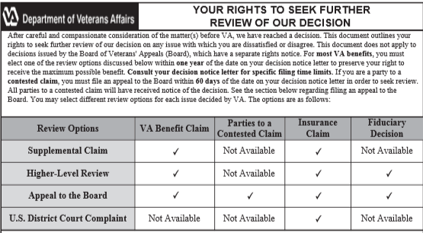
Appeals Process
https://www.va.gov/decision-reviews/

Slide 15
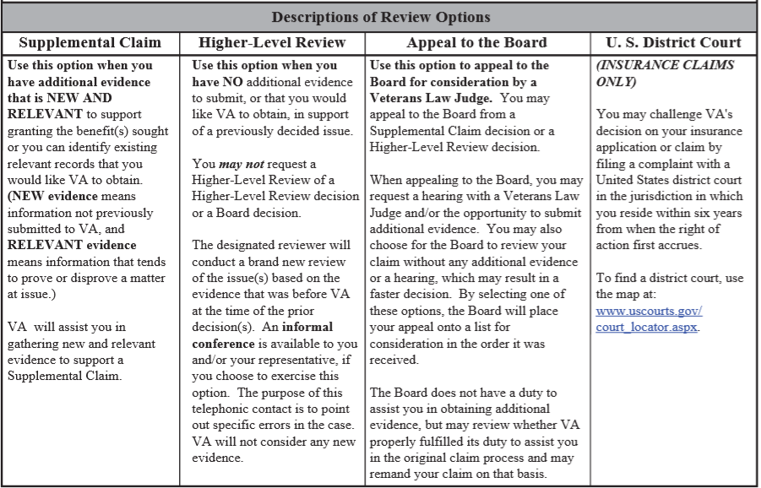
Appeals Process
Contact our office if are appealing a decision.

