Slide 1
Service Connected Disabilities
How to file a Disability Claim
Filing a Claim
In house intake information needed to start a claim and a guide as to what forms we will use are on the information table.
If you want to file a claim please take one and fill it out and bring it to our office.

Slide 2
If a veteran has a disease or injury that occurred while in or began while in service they can file a claim for a Service Connected Disability. If the VA approves the claim they may be able to receive a monthly monetary compensation. You cannot receive compensation and a pension at the same time. Take the one that is greater. Pensions are discussed later in this seminar. In this presentation we will discuss the steps necessary to file for a Service Connected Disability Compensation Claim. Serving during Wartime is not a requirement for Disability Benefits. Finding someone who can guide you through the process if essential.
Service Connected Disabilities

Slide 3
Service Connected Disabilities
Why should you use a County Veteran Service Officer
Each county in Indiana has a CVSO.
1. CVSOs are accredited with a Veterans Service Organization like the American Legion, AMVETS, DAV or the VFW? 2. Because CVSOs are trained and certified in the VA claims and appeals processes and can help you with other VA-related needs. 3. CVSOs work on behalf of Veterans and service members - as well as their family, dependents and survivors. 4. A Veteran’s Service Organization will speak to the VA on your behalf. You do not have to be a member to be represented.
5. Filing a claim on your own and making a mistake will cost you time and maybe the entire claim. A (fully developed claim) vs a (standard claim).

Slide 4
What are the benefits of joining a
Veterans Service Organization?
Local Area Posts:
American Legion – Dugger, Hymera, Shelburn, Sullivan and Carlisle Prison
AMVETS – Hi-Way 40 west of Terre Haute
VFW – Sullivan
American Legion Membership – does not have a wartime requirement now
Contact information for these are on the information table.
Also there are membership opportunities for spouses, children and grandchildren.
i.e., Auxiliary & Sons.
Membership Benefits:
Helping fellow veterans, boys and girls state, other programs, they lobby congress
for veteran benefits. Receive Discounts on Auto Rental, Financial & Insurance,
Media & Entertainment, Medical, Moving & Relocation, Retail, Travel & Lodging.

Slide 5
Service Connected Disabilities
Must haves in order to file.
Your DD-214 or other separation documents
Your service treatment records in most cases except for hearing claims
Any medical evidence related to your illness or injury (like doctor’s reports, X-rays, medical test results or doctor’s opinion)
Buddy statements if needed to prove an incident or location during service.
As of January 2020 ship logs or other proof that you were off of Vietnam coast for Agent Orange related claims.
Marriage license, children’s birth certificate if 30% or more to claim them as a dependent for on your claim.
Supporting documentation including statements that explain circumstances.
For hearing it would be a statement to explain what loud noises you were exposed to.

Slide 6
Service Connected Disabilities
Must haves in order to file - continued.
It takes a lot of time to gather all of the information.
The VA allows you to file an Intent to File.
This gives you a year to gather the documents and
You will not loose your effective date.
The effective date is the date that they received your intent to file
if no intent to file was sent then the date that your claim was received.
Best to file an intent to file.
You will receive back pay to one of these dates if your claim is approved.

Slide 7
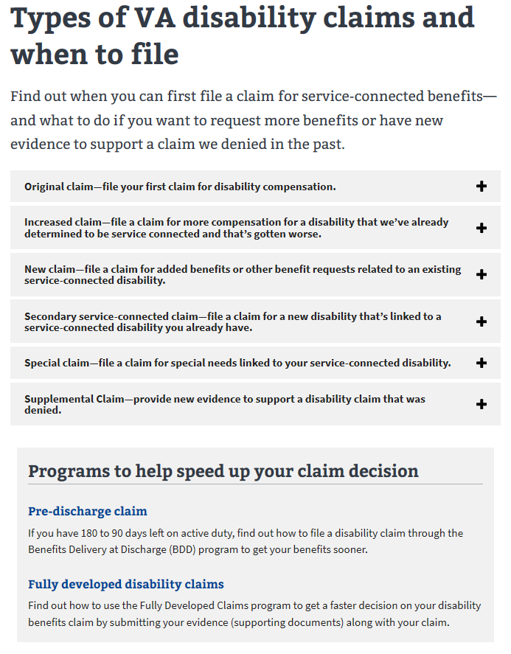
Service Connected Disabilities
See next slide
See next slide
Did not appeal
FDC very important

Slide 8
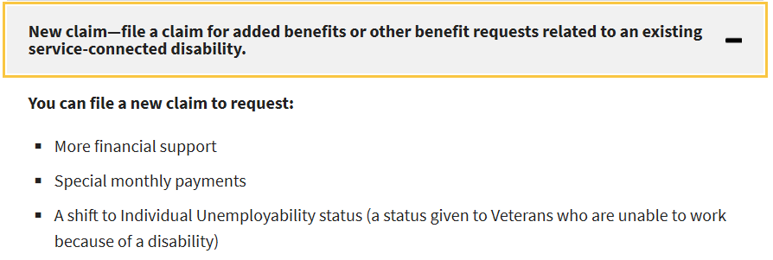
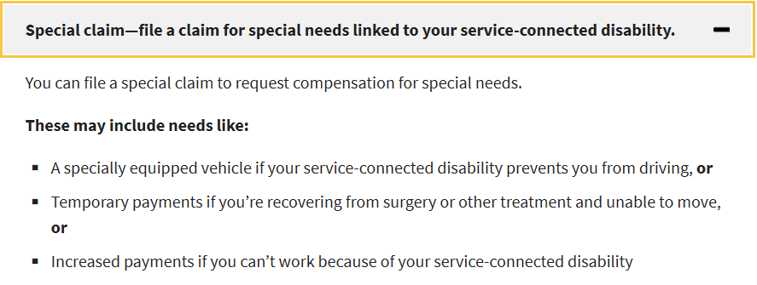
Service Connected Disabilities
Example: if you need help dressing, eating, and bathing

Slide 9
Service Connected Disabilities
Fully Developed Claim (FDC) – Good, faster claim process
Standard Claim – Bad, slower claim process
FDC – Remember, the VA itself has a duty to assist you but if they help by getting your records instead of you supplying all that they need to make a decision it will probably slow down the claims progress. If they assist it will move to the Standard Claim process.
A VSO will assist but it is your responsibility to gather the documentation.
What is needed?
Active duty can get medical, personnel & discharge records at archives.gov. National Personnel Records Center (NPRC)
Injury could have happened on the base or off the base.
Hearing and Tinnitus do not require you to submit medical records.
The VA will contract an exam for you for a hearing exam.
For VA medical records contact
INDY - RELEASE OF INFORMATION: for records 317-988-2326 FAX 317-988-5484
Send the request to: Richard L. Roudebush VA Medical Center Attn: Release of Information 1481 West 10th Street. Indianapolis, IN 46202
You can also appear in person.

Slide 10
Service Connected Disabilities
For VA medical records contact - continued
National Guard or Reserve
NPRC does not have records for active/inactive Reserve or National Guard members. These records are located with each state’s Adjutant General’s Human Resources or Personnel Command.
Indiana State Archives Mailing Address: 6440 East 30th Street, Indianapolis, Indiana 46219 Phone: (317) 591-5222 Fax: (317) 591-5324 E-mail: arc@icpr.in.gov or see the Contact Form
Call our office
How does the VA determine your percentage of disability?
EXAMPLE OF VA MATH when your disabilities are 40% + 20% + 10% + 10% = 80% But VA says only 60%. ☹
Calculator for figuring your combined disability rating. http://www.vvaarizona.org/combined_disability.php
See next slide for an example of VA Math.

Slide 11
Don’t over think this. Just know that it is not basic addition.
YOU ARE STARTING AT 100%
HERE ARE YOUR RATINGS
100%
90%
80%
If THE VA added these ratings up, your combined rating would be 80%....
70%
60%
40%
20%
10%
10%
50%
BUT…
40%
30%
The VA Does Not just add them up.
The VA uses the COMBINED RATING SCALE
20%
10%

Slide 12
VA Math:
100%
YOUR RATINGS
90%
80%
YOUR COMBINED RATINGS
70%
STEP #4
CONTINUED
60%
40% leave 60%
10% leave 50%
10% leave 40%
60% COMBINED
50%
40%
40%
20%
10%
10%
*100=40%
*60=12%
*50=5%
*40=4%
30%
20%
10%
(4 left over)

Slide 13
VA Math:
100%
YOUR RATINGS
90%
CONCLUSION
80%
70%
60% COMBINED
With 30% of you left
And
(4%) left to add to any future new ratings
60%
50%
40%
20%
10%
10%
40%
30%
20%
10%
(4)
If you get another 10% * 30%=3 so 3 + (4)= 7 round to 10%.
Now you can add that 10% making you 70%.

Slide 14
Guidelines for Claims
Code of Federal Regulations (CFR) 38 Part 3, Part 4 and M-21 are tools that the VA reviewer
references when adjudicating a claim. Click on hyperlinks below.
https://www.knowva.ebenefits.va.gov/system/templates/selfservice/va_ssnew/help/customer/locale/en-US/portal/554400000001018/content/554400000073398/M21-1,%20Adjudication%20Procedures%20Manual,%20Table%20of%20Contentshttps://
www.law.cornell.edu/cfr/text/38/part-3
https://www.law.cornell.edu/cfr/text/38/part-4

Slide 15
Guidelines for Claims
References the VA reviewer used for deciding a claim.
https://www.law.cornell.edu/cfr/text/38/part-3
See next slide for a compensation and disability definitions.

Slide 16
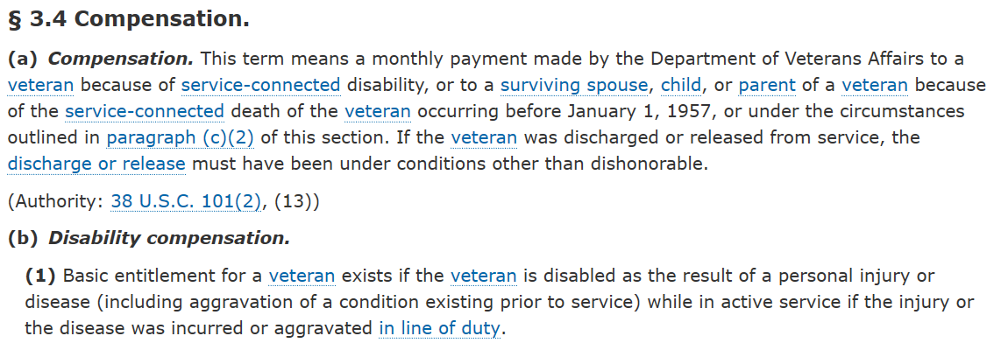
Guidelines for Claims
References the VA reviewer used for deciding a claim.
Example Below:
https://www.law.cornell.edu/cfr/text/38/part-3

Slide 17
Disability Ratings are found in the 38 CFR (Code of Federal Regulations) Part 4 https://www.law.cornell.edu/cfr/text/38/part-4/subpart-B See next slide.
Service Connected Disabilities
References the VA reviewer uses when deciding a claim.

Slide 18
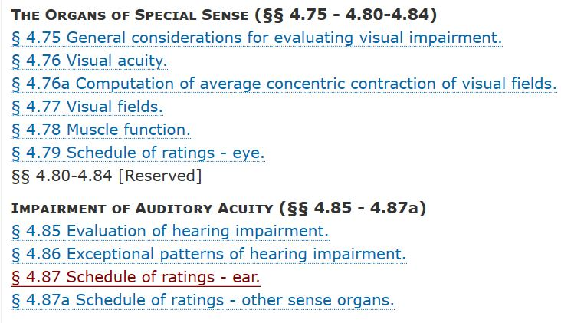
Service Connected Disabilities
38 CFR Part 4 Code of Federal Regulations for Disabilities
Example
See next slide for ratings for – ear example.

Slide 19
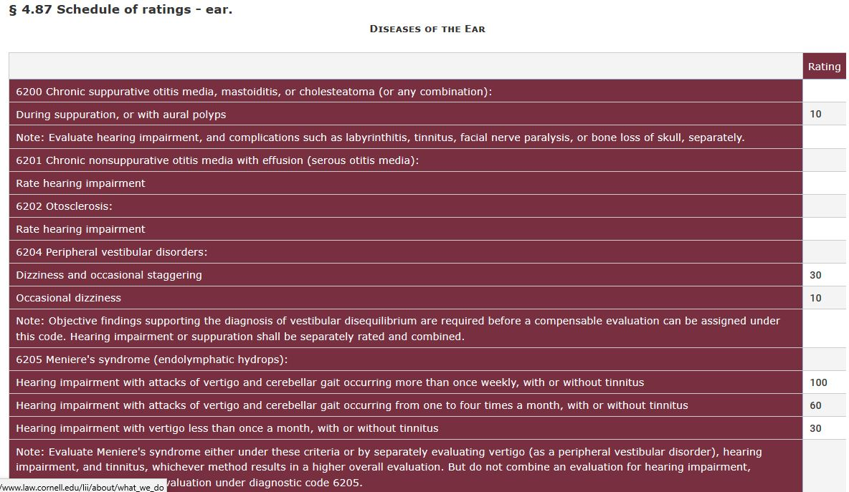
38 CFR Hearing Schedule of Ratings Part 4
Service Connected Disabilities

Slide 20
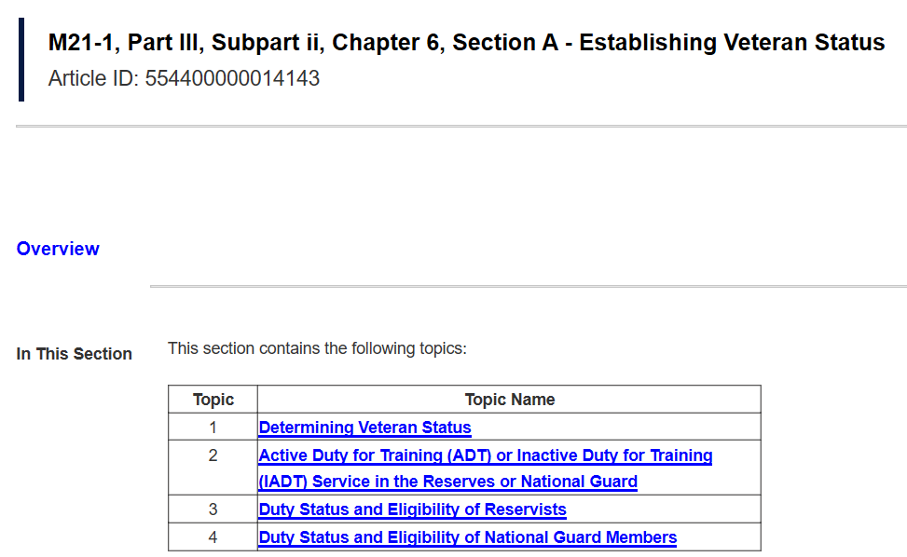
Service Connected Disabilities
M21-1 Compensation and Pension Manual, example.
References the VA reviewer uses when deciding a claim.

Slide 21
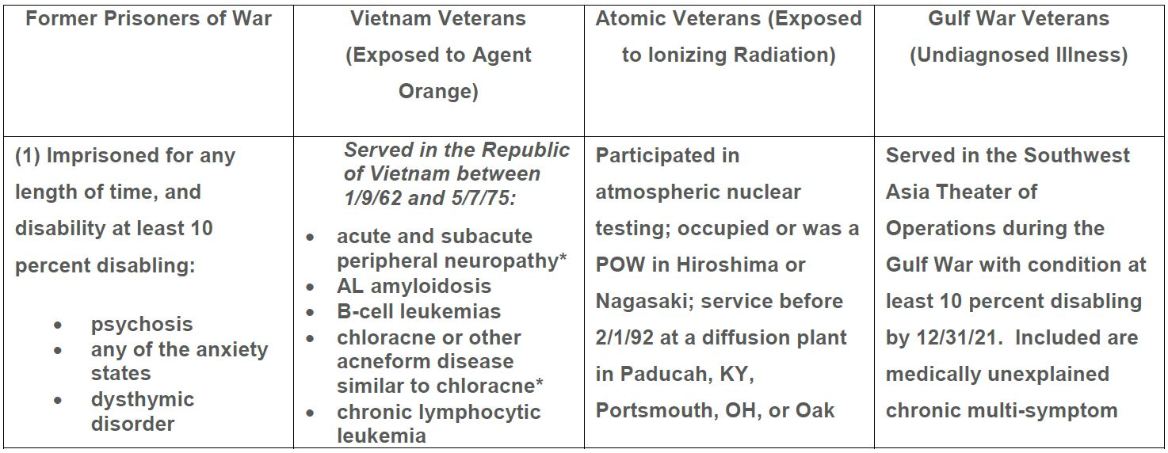
Service Connected Disabilities
Presumptive Disability Benefits
If you experienced or were in contact with these you are presumed to have diseases, injuries or mental health issues related to these exposures.
Presumptive columns continued on the next slide.

Slide 22
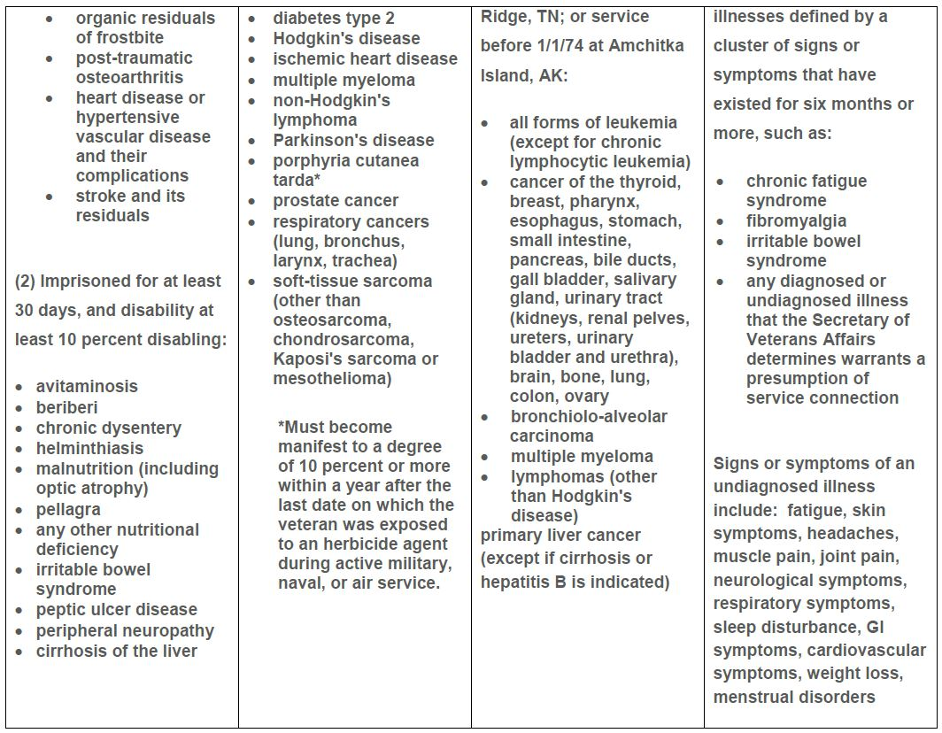
Service Connected Disabilities
Presumptive Disability Benefits Continued

Slide 23
Service Connected Disabilities
Presumptive Disability Benefits Continued

Slide 24
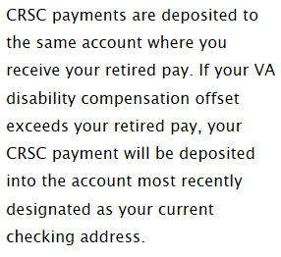
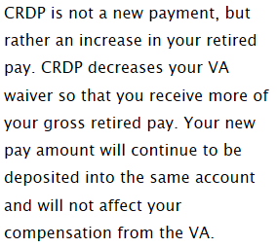
Service Connected Disabilities
(Skim over) For Retired Military Combat Related Special Compensation (CRSC) and
Concurrent Retirement and Disability Pay (CRDP) automatically figured by the VA.
Fact sheet on the information table.
CRSC basic eligibility
Rated at 10% disability and 60 years old and have waived their VA pay for their retired pay.
CRDP basic eligibility
20 years active or reserve, receiving retired pay that is offset by VA payments, 50% disabled. Reserve and guard must
Be eligible…
https://www.dfas.mil/retiredmilitary/disability/comparison.html

Slide 25
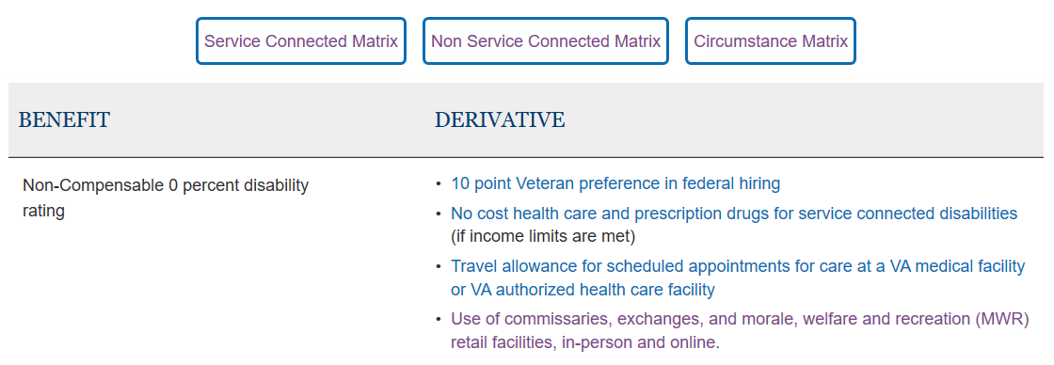
Benefits for SC, non-SC or Circumstance
EXAMPLE OF SERVICE CONNECTED.
Matrix shows what you or family members might be entitled to. Too numerous to show on screen.
Handouts are on the information table. https://www.benefits.va.gov/benefits/derivative_sc.asp

Slide 26
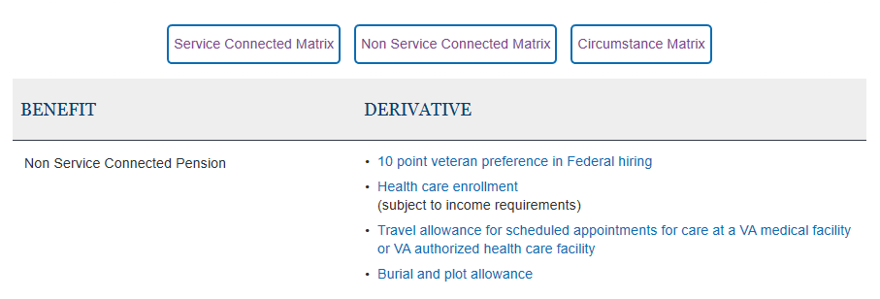
Benefits for S C, non-SC or Circumstance
EXAMPLE OF NON SERVICE CONNECTED.
Matrix shows what you or family members might be entitled to. Too numerous to show on screen.
Handouts are on the information table. https://www.benefits.va.gov/benefits/derivative_nsc.asp

Slide 27
Benefits for S C, non-SC or Circumstance
EXAMPLE OF CIRCUMSTANCE.
Matrix shows what you or family members might be entitled to. Too numerous to show on screen.
Handouts are on the information table. https://www.benefits.va.gov/benefits/derivative_circumstance.asp

Slide 28
Service Connected Disabilities
Unemployability
Unemployability allows VA to pay certain Veterans compensation at the
100% rate, even though VA has not rated their service-connected disabilities at the 100% level.
What is the eligibility criteria for individual unemployability?
• You must be a Veteran
• You must have at least one service connected disability rated at least at 60%, OR
• Two or more service connected disabilities at least one disability ratable at 40% or more with a
combined rating of 70% or more.
• You must be unable to maintain substantially gainful employment as a result of service-connected
disabilities (marginal employment, such as odd jobs, is not considered substantial gainful employment
for VA purposes).
https://www.benefits.va.gov/BENEFITS/factsheets/serviceconnected/IU.pdf
See the fact sheet on the information table.

Slide 29
Lets take a Break before covering Low Income VA Pensions

